Slide 1
Harmony Graphics Hands-On Training

Slide 2

Agenda
Designing with Graphics Composer
Navigating Basic Widgets and Schemes
Managing Events
Dynamic Strings
Animations
Running the Final Application

Slide 3
Hardware Set-up

Slide 4
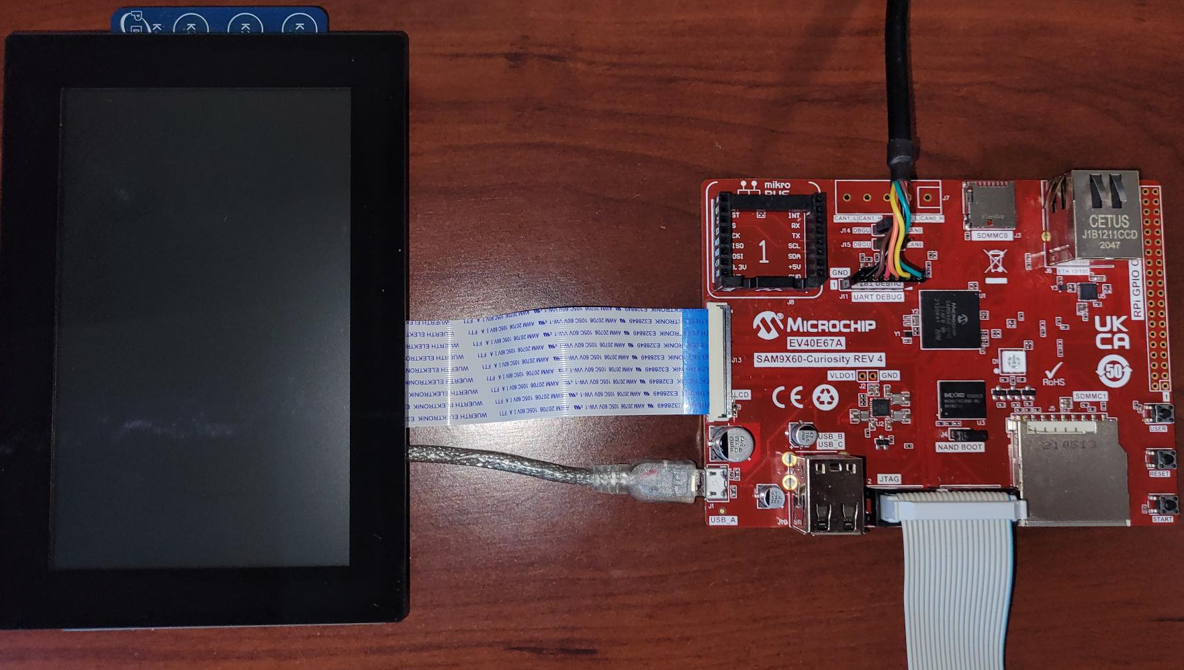
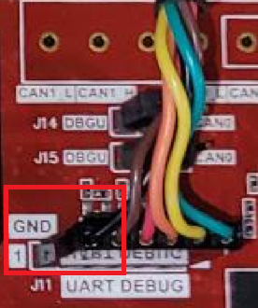
Hardware Requirement
FTDI cable
(Optional)
SAM9X60 Curiosity
(EV40E67A)
USB Cable for power
External JTAG Debugger
WVGA Display Module with
Max-Touch®AC320005-5)

Slide 5
Software Requirements

Slide 6
Software Required
MPLAB X IDE Version 6.05
https://ww1.microchip.com/downloads/aemDocuments/documents/DEV/ProductDocuments/SoftwareTools/MPLABX-v6.05-windows-installer.exe
XC32 Compiler Suite Version 4.20
https://ww1.microchip.com/downloads/aemDocuments/documents/DEV/ProductDocuments/SoftwareTools/xc32-v4.20-full-install-windows-x64-installer.exe
MPLAB Harmony 3 Framework
Harmony Software | Version | Download Link (Github)
BSP | v3.14.0 | https://github.com/Microchip-MPLAB-Harmony/bsp.git
Core | v3.11.1 | https://github.com/Microchip-MPLAB-Harmony/core.git
CSP | v3.13.1 | https://github.com/Microchip-MPLAB-Harmony/csp.git
Devices | N/A | https://github.com/Microchip-MPLAB-Harmony/devices.git
Dev_Packs | v3.13.1 | https://github.com/Microchip-MPLAB-Harmony/dev_packs.git
GFX | v3.12.0 | https://github.com/Microchip-MPLAB-Harmony/gfx.git

Slide 7
Before you start the LAB…

Slide 8
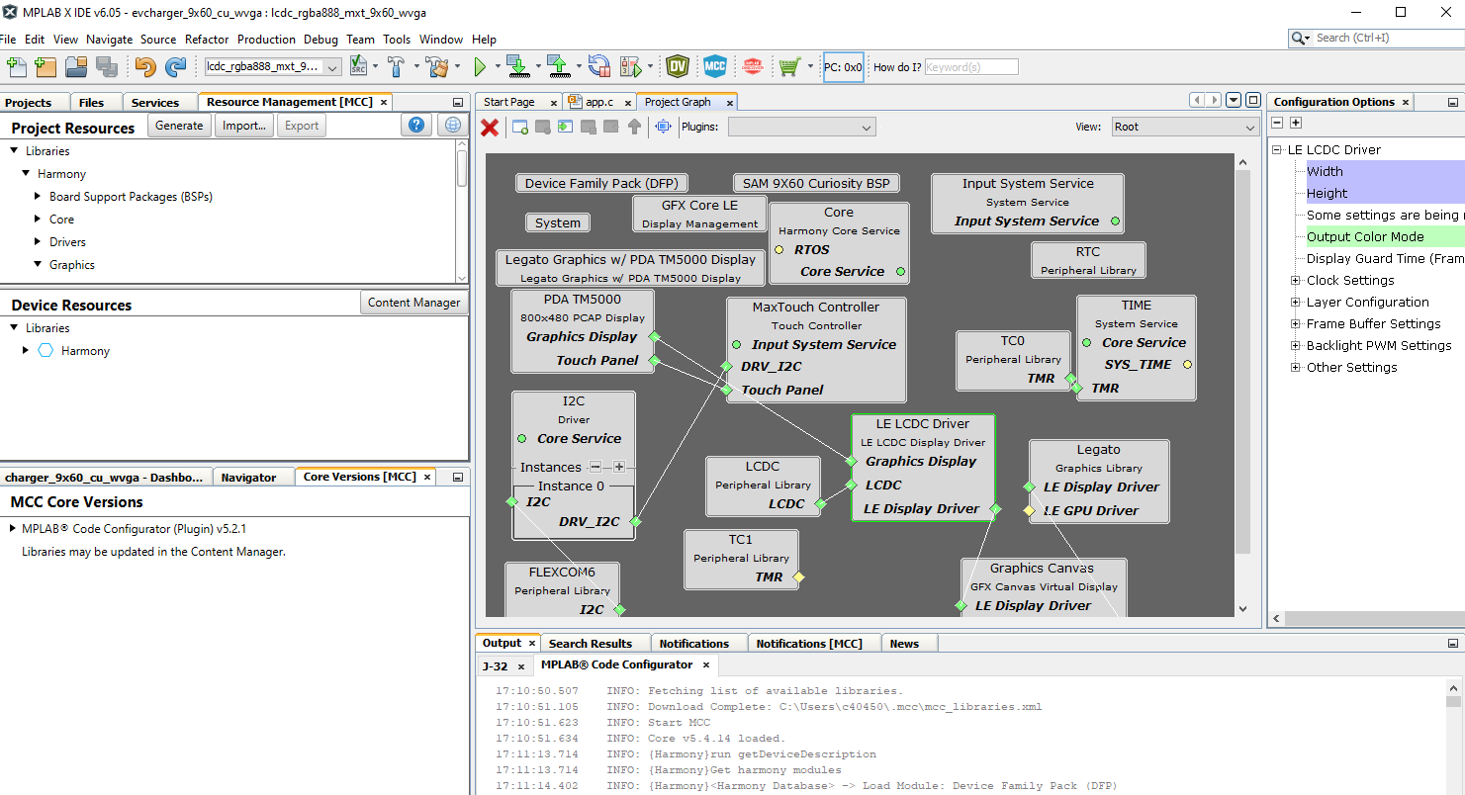
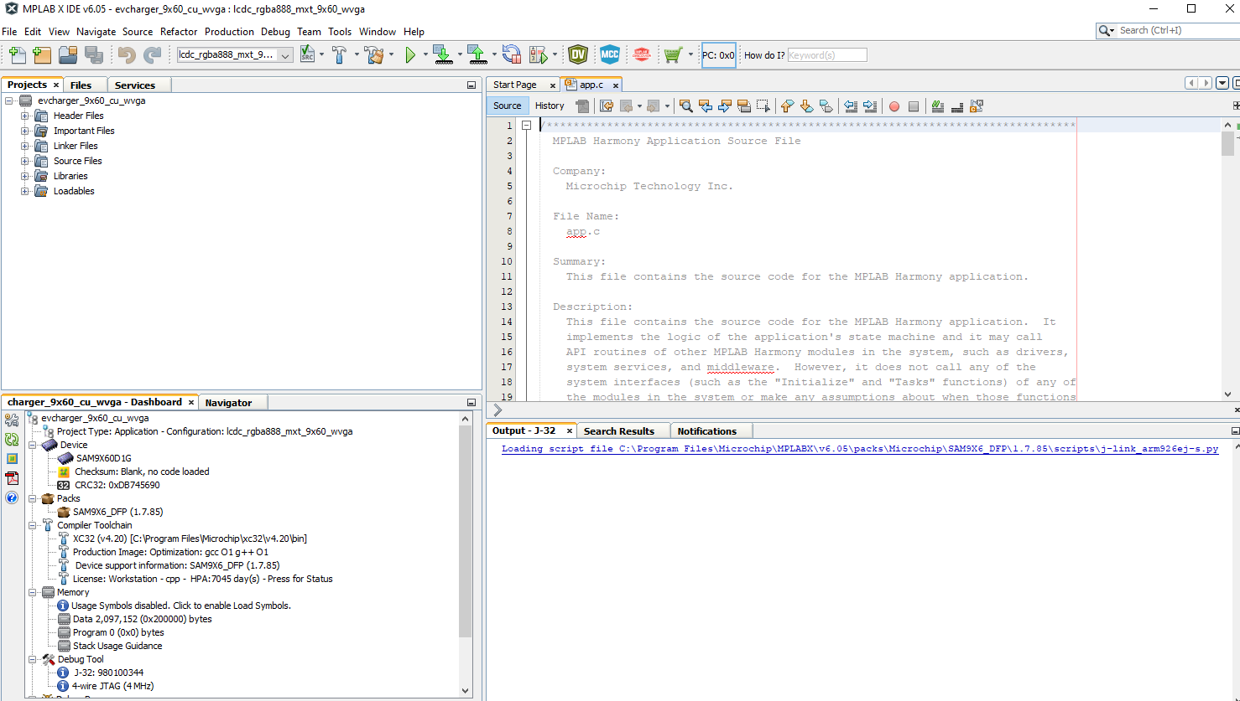
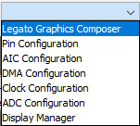
MPLAB® Code Configurator
Code Generation
Components
Project Graph
Config Options
MCC Plugin version
Configured using MGC
MCC Core version

Slide 9
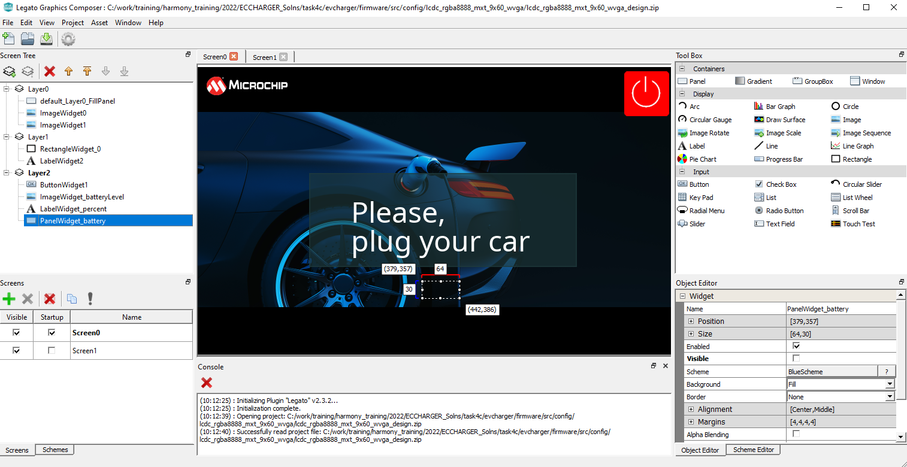
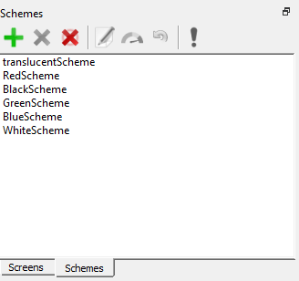
Microchip Graphics Composer (MGC)
Widgets Tool Box
Screen Designer
Design Tree View
Object Editor
Screen manager
Schemes manager

Slide 10
EV Charger Application

Slide 11
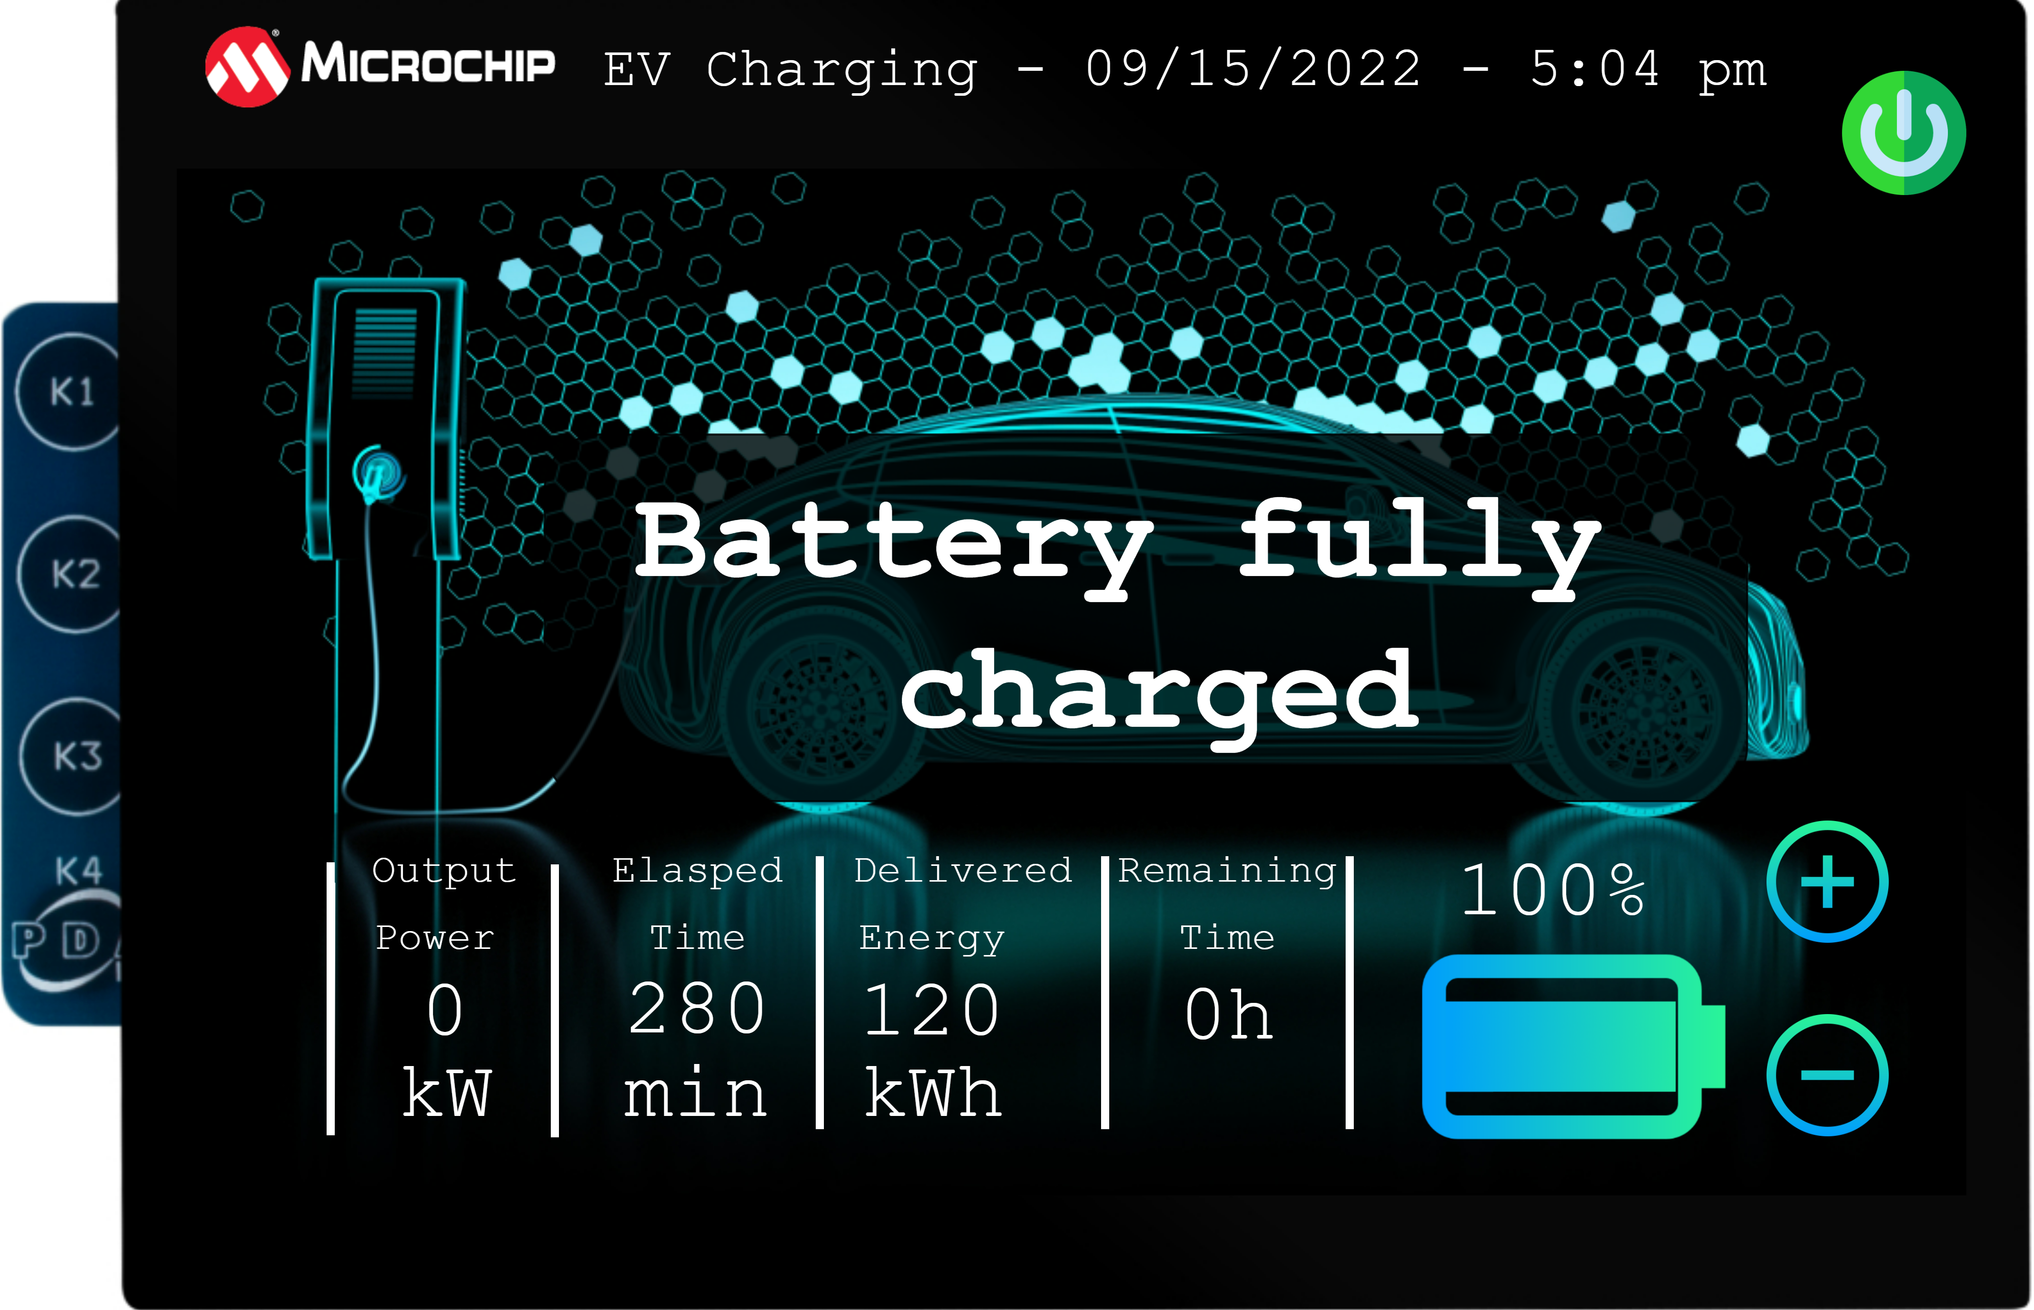
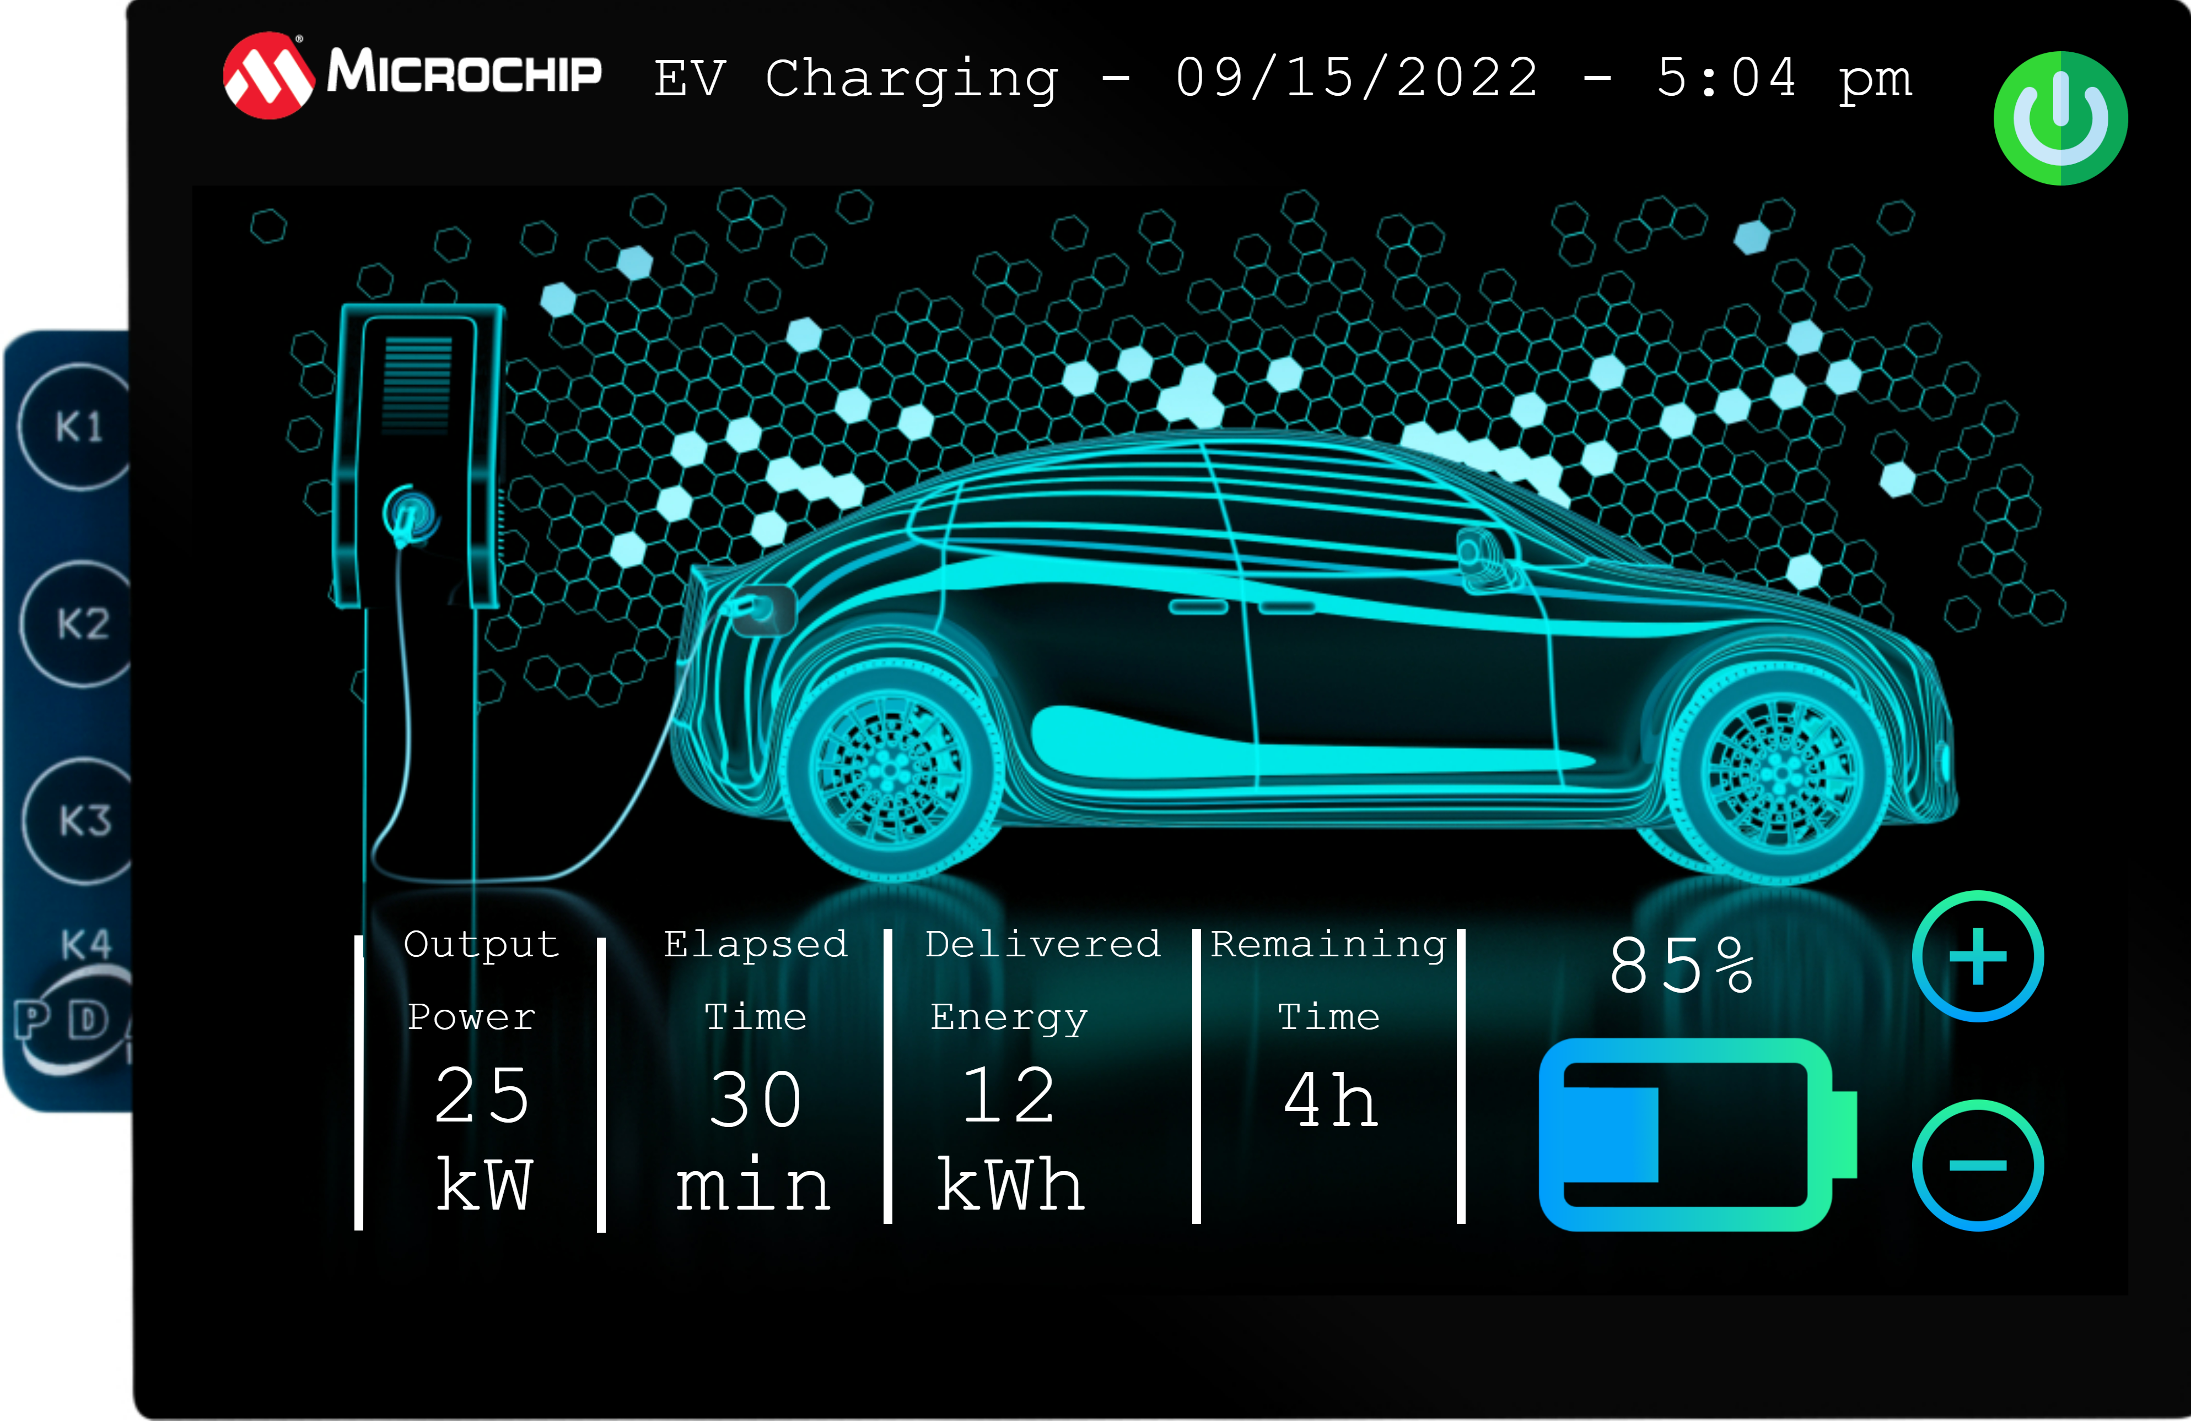
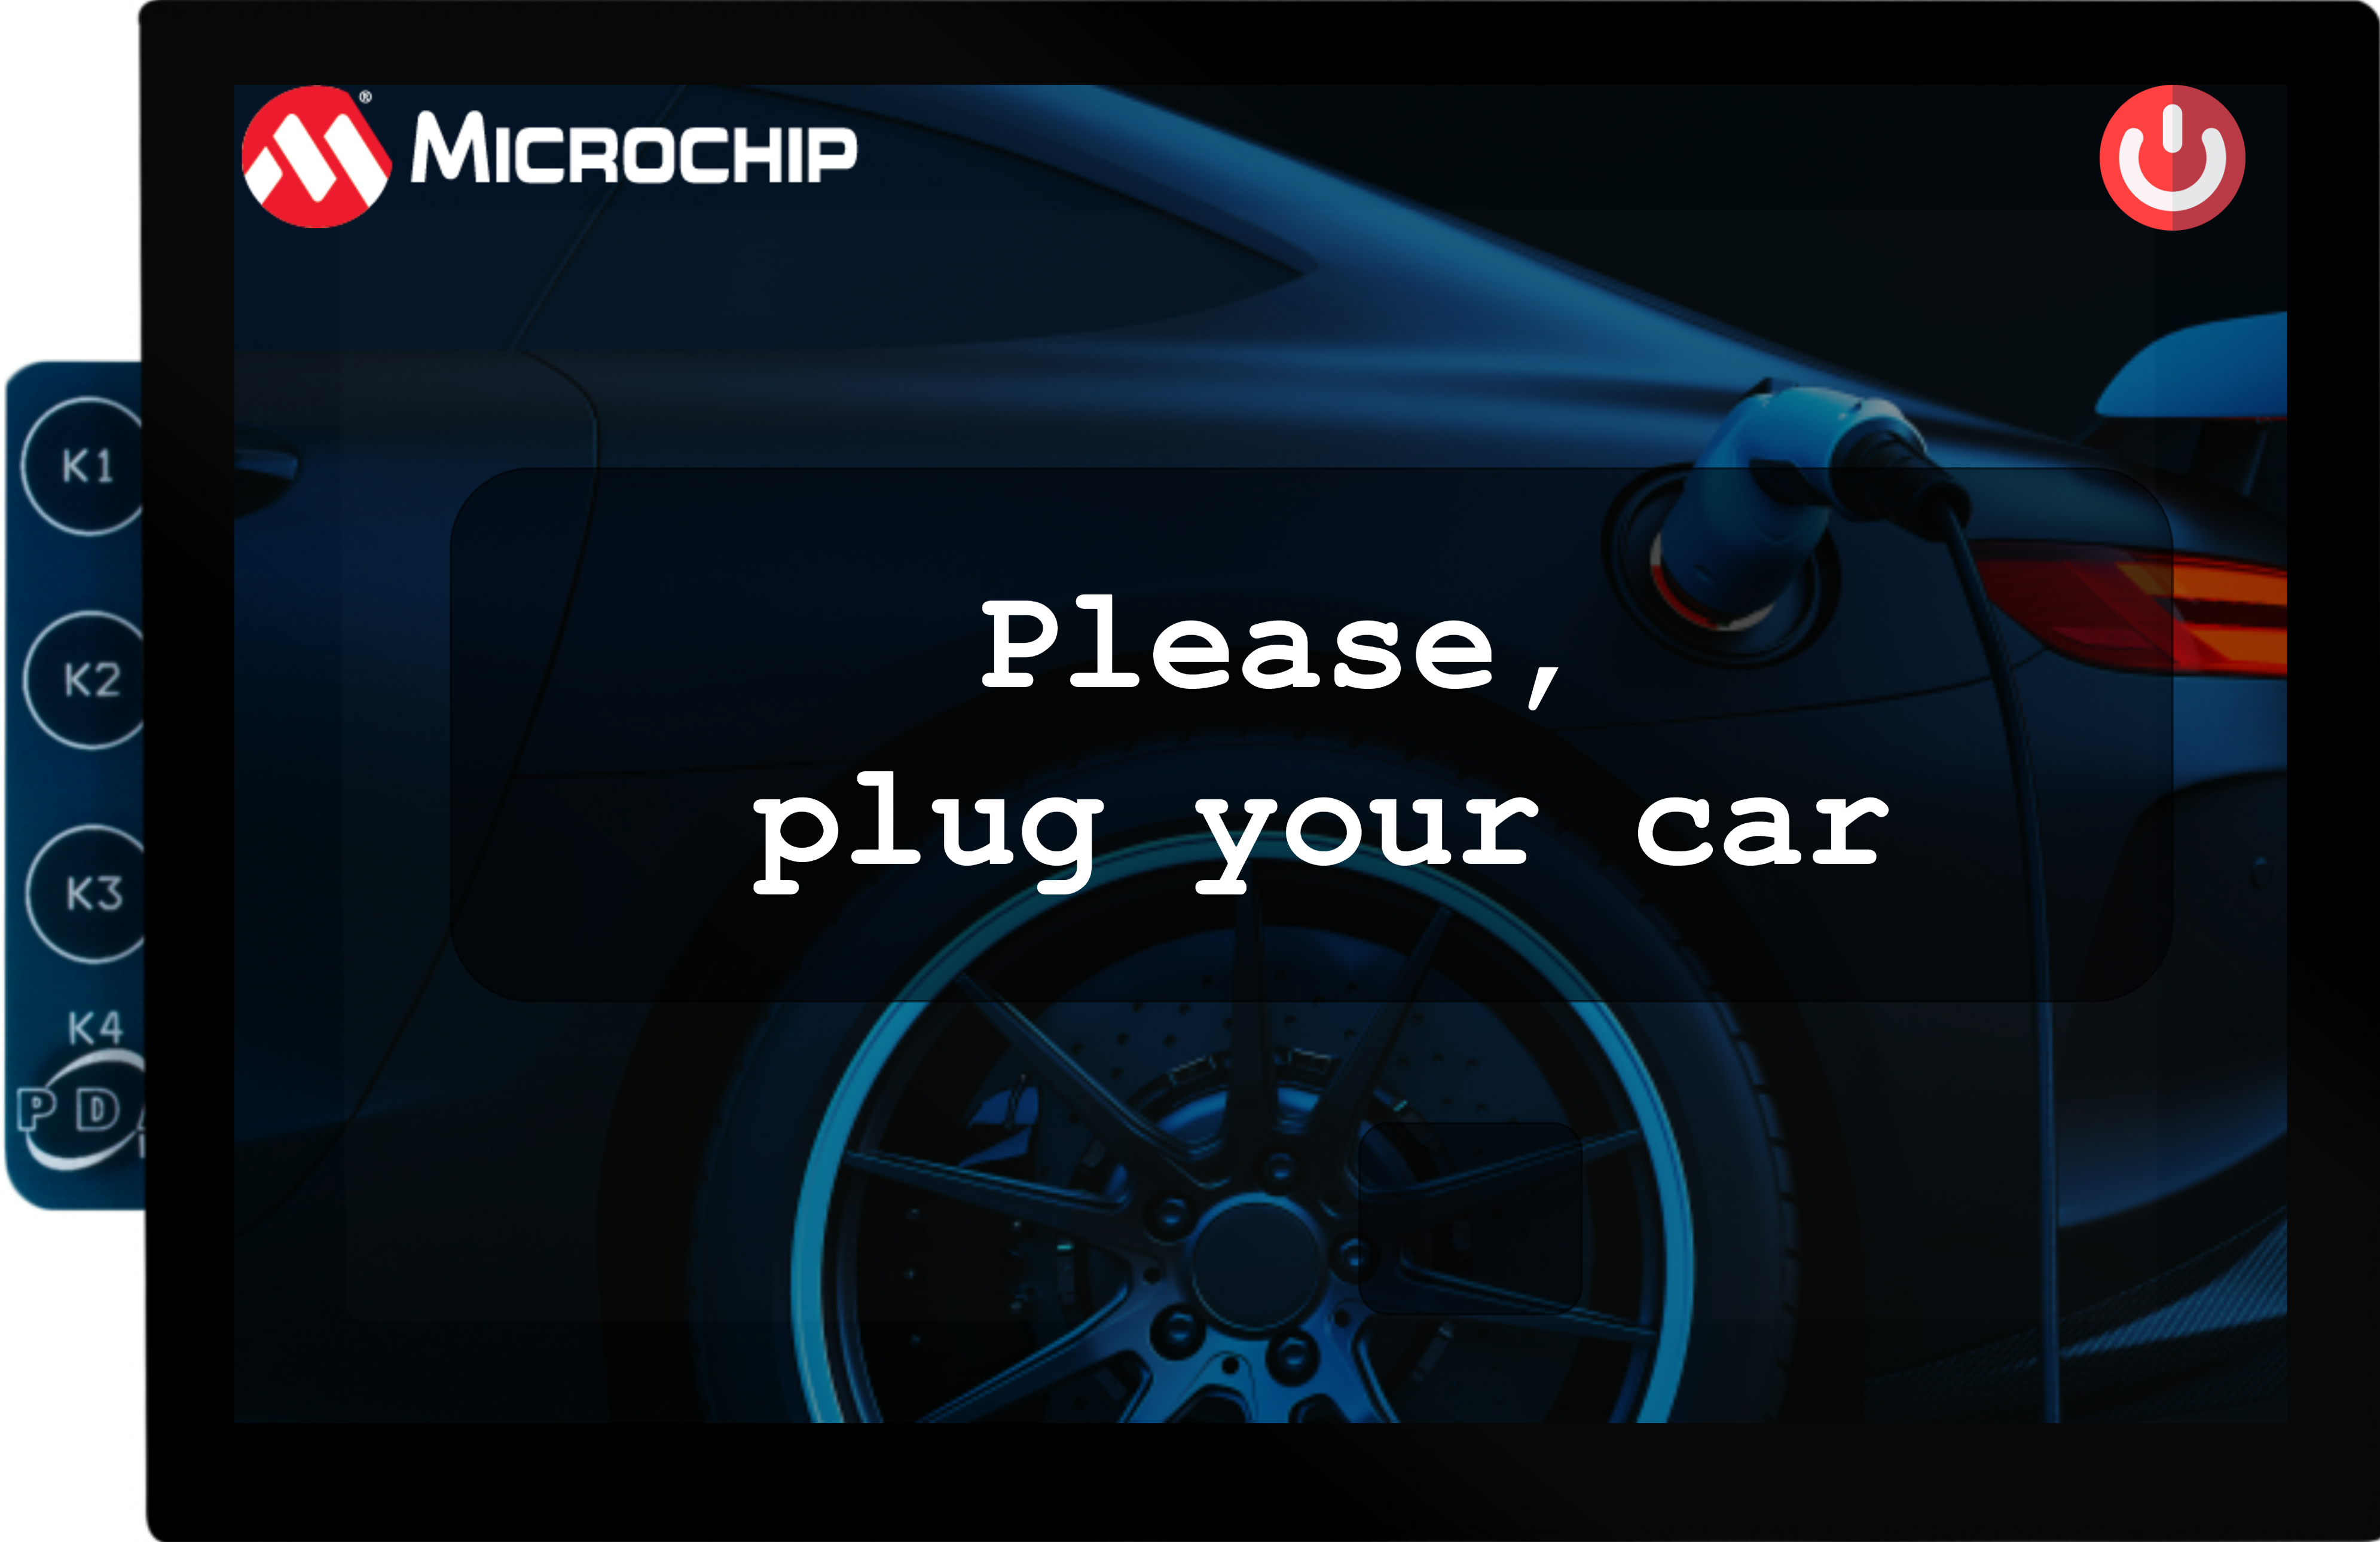
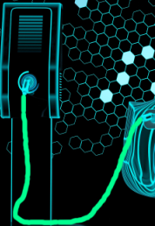
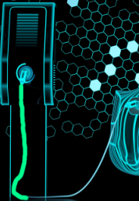
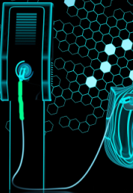

The EV Charger Application
Pressing green power button takes user back to previous screen
Press + to reach 100%
Green wire animation for the cable
Press – to remove the pop up message
Pressing the plus or minus buttons will change the meter label and the battery level

Slide 12
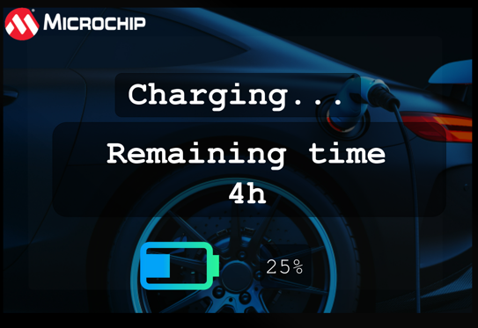
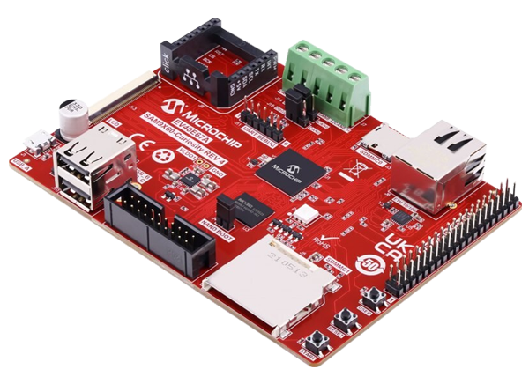
The EV Charger Application
If idle for 10 s screen saving mode is entered
Press user push button to go back to previous screen

Slide 13
Task 1
Managing Simple widgets and schemes

Slide 14
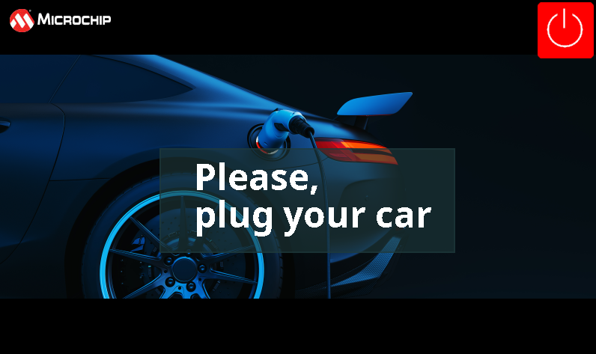
Task 1

Slide 15
Task 1
Create an MCC project from scratch
Using Microchip Graphics Composer create a design
Using Asset Manager add: Images, Fonts, Strings
Add Image, Label and Button widgets
Add/Modify Schemes
What is Scheme?

Slide 16
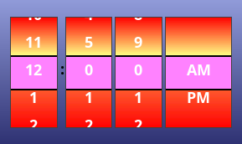
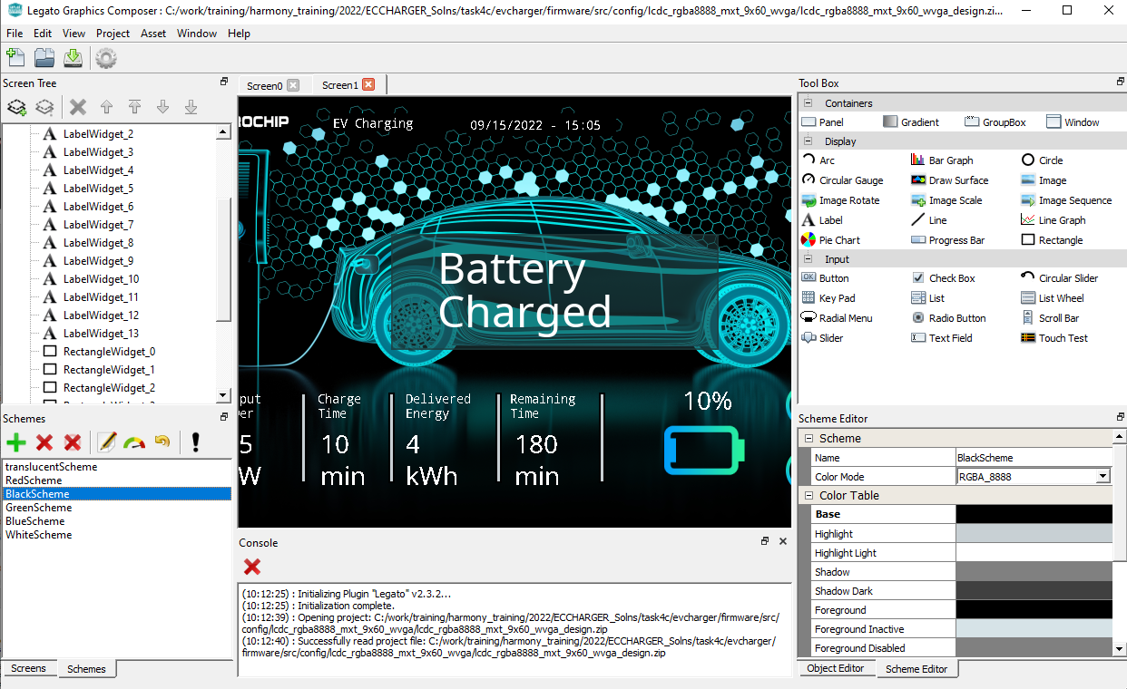
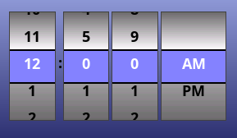
Color Schemes
A color scheme is an arrangement of colors used to draw various parts of a widget
Provides variability in look-and-feel
Transparent Scheme
Scheme Editor
Scheme List

Slide 17
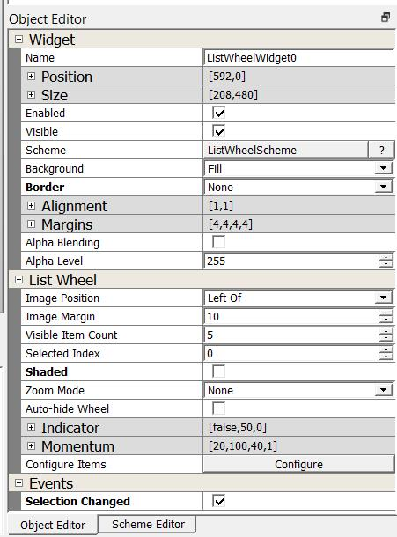
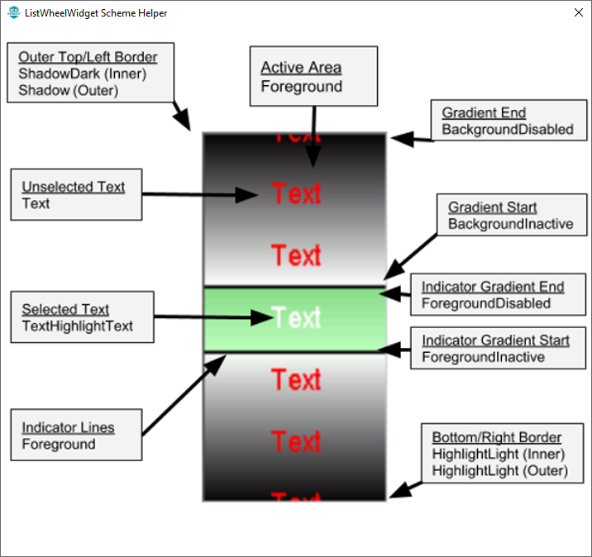
Widget Customization Using Scheme
Customize the colors of a widget
Scheme Helper

Slide 18
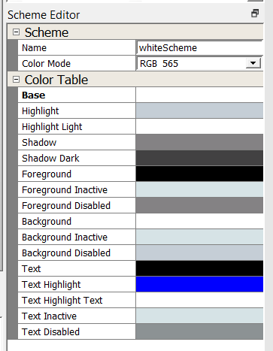
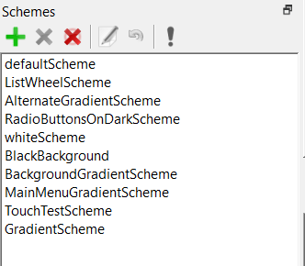
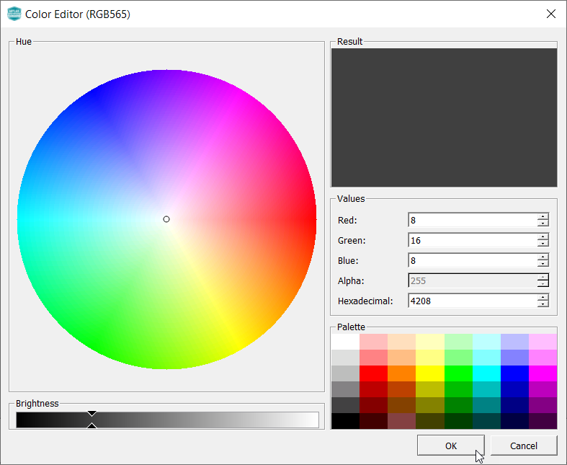
Scheme Management
Customize Scheme using Scheme editor & color picker
Scheme Editor
Scheme Manager
Scheme Color Picker
Alpha value adds transparency

Slide 19
Task 2
Managing Events & Screen Transitions

Slide 20
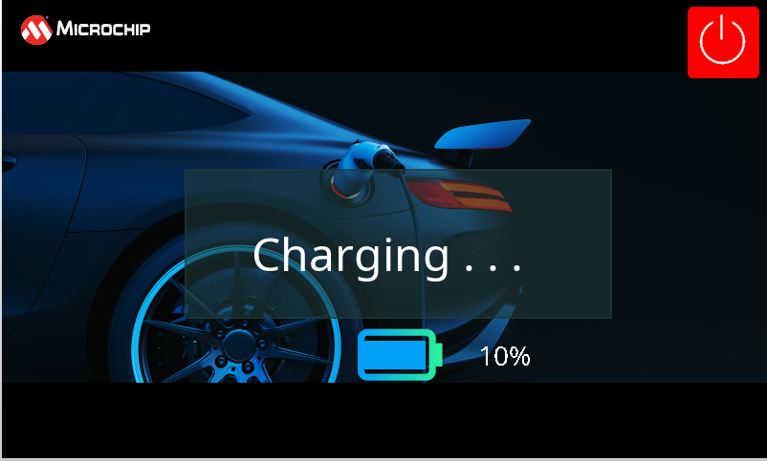
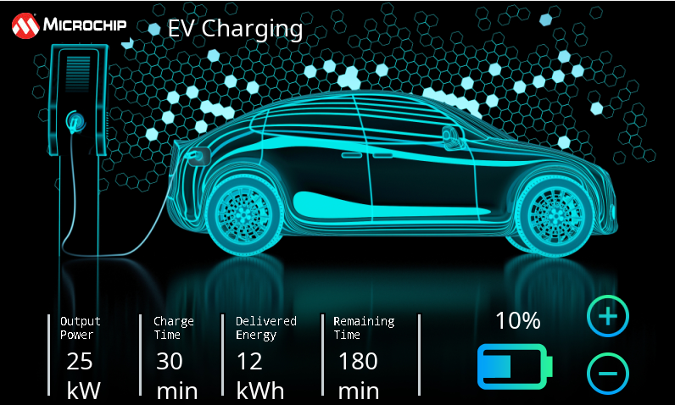
Task 2

Slide 21
Events Handling
Graphics Library
Screen Change
Touch Input
Property Change
Screen Event
Widget Event
Event Callbacks
What can callbacks do?
Widget Event Callbacks
Call library functions to update the UI
Call driver or PLIB functions to control hardware
Call app functions to perform business logic
Screen Event Callbacks
On Hide
Pressed
On Show
Released
On Update
Other
Event Callbacks
Library Functions
Driver or PLIB Functions
Application Functions

Slide 22
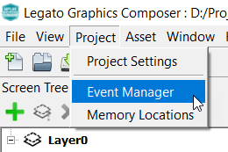
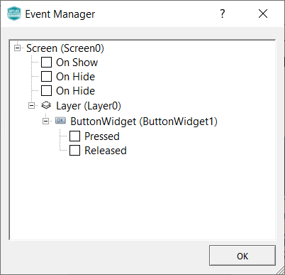
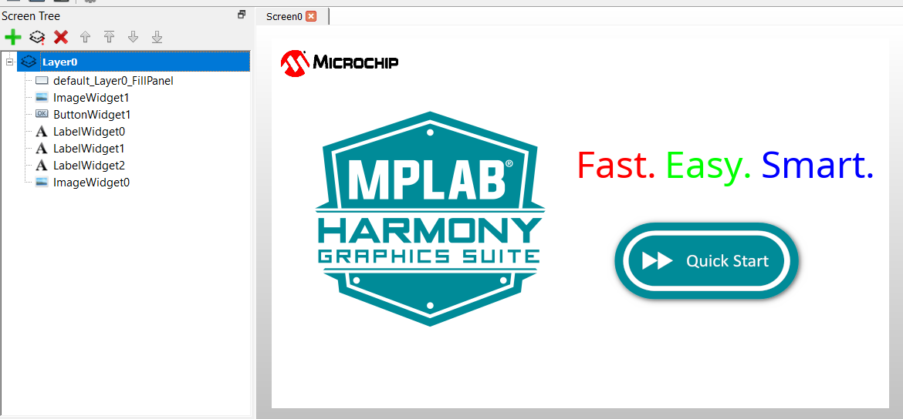
Events Management
Using the Event Manager
Event Manager
Interface to enable/disable event callbacks for a screen and all the event-capable widgets in it
Screen0

Slide 23
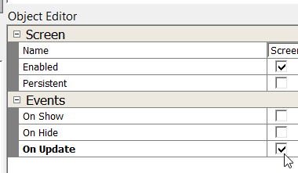
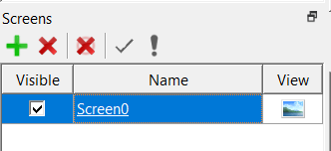
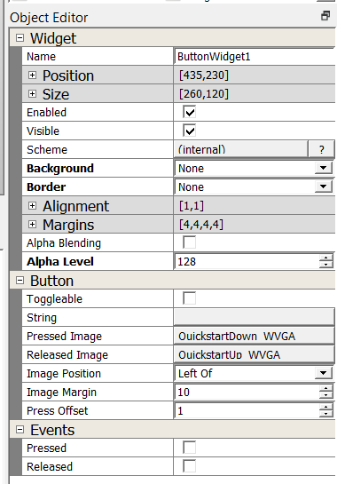
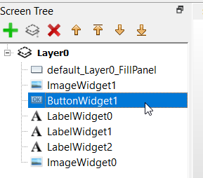
Events Management
Using the Object Editor
Enable/disable event callbacks for selected Screen or Widget

Slide 24
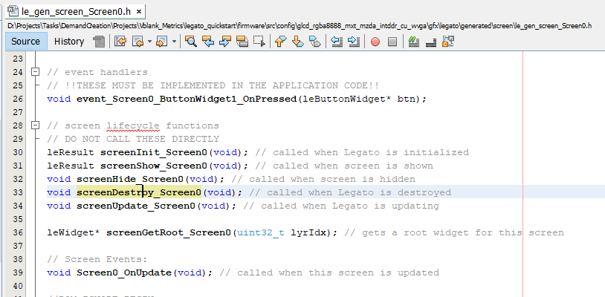
Event Callbacks
Event Code Generation
Callback functions for enabled events are declared and called by the library
Event callback functions must be user-defined in application code
Generated Screen Header File
Widget Event Callbacks
Need to be defined in application code
Screen Event Callbacks
Need to be defined in application code

Slide 25
Screen Events
Event Callbacks
<Screen>_OnShow()
Called right after the screen and children widgets are created
TIP: Use to allocate and initialize run-time screen objects (e.g., strings)
TIP: Use to restore widget states
<Screen>_OnUpdate()
Called right before the screen and children widgets are updated and redrawn.
This is periodically called inside the Legato task.
TIP: Use to manage screen application states
TIP: Use to set widget properties
<Screen>_OnHide()
Called right before the screen and children widgets are destroyed/freed*
TIP: Use to delete and free allocations for run-time screen objects
TIP: Use to save widget states
*screens marked ‘persistent’ are not destroyed when hidden and all dynamic allocations are preserved in memory.

Slide 26
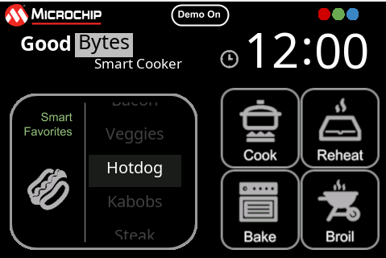
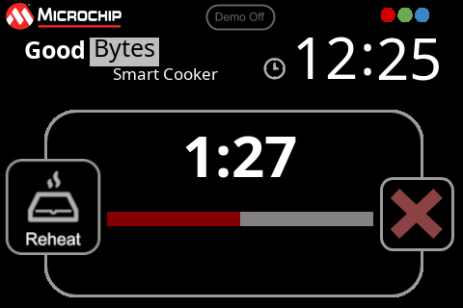
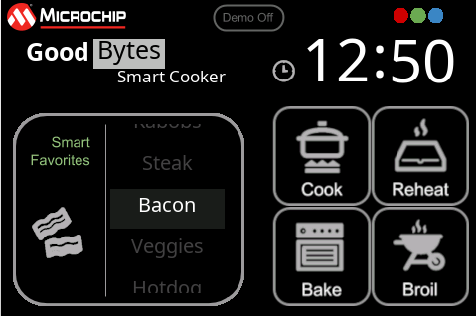
Screen Events
Event Callbacks
MainMenu_OnShow()
Construct dynamic string objects
Restore toggle button state
MainMenu_OnUpdate()
Manage screen state machine
Handle application events
Use library APIs to update Widget properties
MainMenu_OnHide()
Destroy dynamic string objects
2
1
1
Legato Cooker

Slide 27
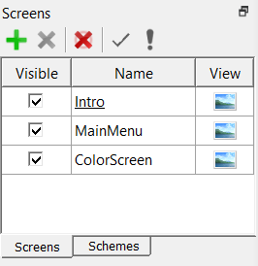
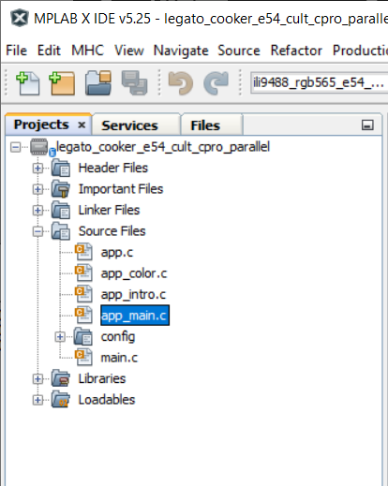
<Screen>_OnUpdate()
Best Practices
1. Define all callback functions for a screen and widgets inside a screen-specific application source file
Cleaner project since screen-specific code are in one source file
Screens in Composer
Screen-specific application source files
2. Always call Legato Widget APIs in <Screen>_Update().
Guarantees that the screen and widgets exist
Eliminates race condition in RTOS-based projects
Legato Library Task
MainMenu_OnUpdate()
Manage application screen states
Set widget properties (i.e., call Legato Widget APIs here)
External Tasks
(Application, Peripheral Drivers)
event

Slide 28
Task 3
Dynamic String and RTC

Slide 29
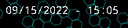
Task 3

Slide 30
Dynamic String
Define a Legato String Object (leFixedString) and allocate memory
Set a font to the string object
Set the desired Label widget with the String object
Reference: https://github.com/mchpgfx/legato.docs/wiki/How-to-Show-Dynamic-Labels
//Legato string object
leFixedString p_timestring;
leFixedString_Constructor(&p_timestring, p_legatoTimeBuff, MAX_TIME_STRING_LEN *2);
p_timestring.fn->setFont(&p_timestring, (leFont*)& NotoMono14);
Screen1_rtc_label->fn->setString(Screen1_rtc_label, (leString*)&p_timestring);

Slide 31
Task 4
Sprite Animation Using Canvas
& Importance of HW Overlays and Multi-Layers

Slide 32
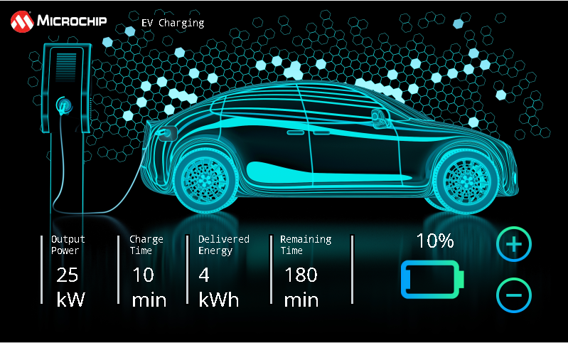
Task 4 - Canvas
Cycle through 14 images

Slide 33
HW Overlays and Multi-Layers
Using the Integrated Display Controller

Slide 34
Multi-Layer Compositing
Sources
Output Frame
Compositing
Hello World
Hello World
Compositing*
Combining of visual elements from separate sources into single images
To create the illusion that all those elements are parts of the same scene

Slide 35
Hardware Compositing
Integrated Controller HW Overlays
Frame Buffers
Output Frame
Graphics Library
Display Controller
Hello World
Hello World
HW Overlays
The LCD Controller in Microchip MPUs have multiple hardware overlays
The graphics library renders to a frame buffer for each HW overlay
The display controller composites the overlays into a single frame.
Dynamic content with minimal load on the CPU, and no GPU needed.

Slide 36
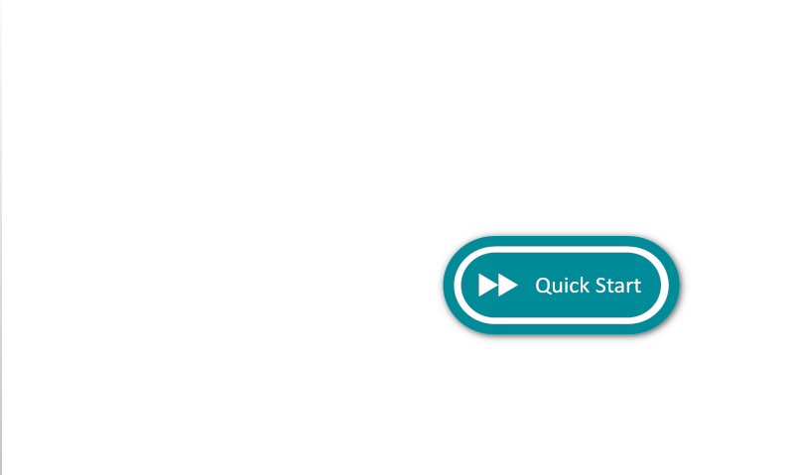
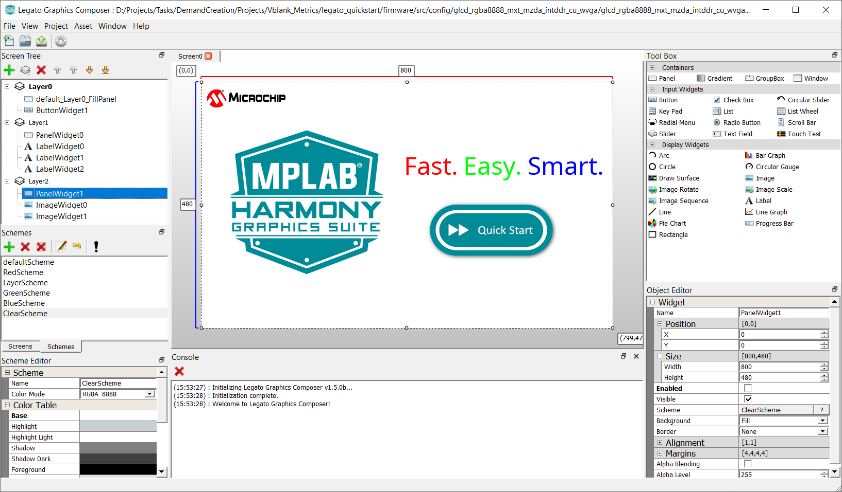
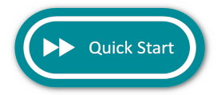
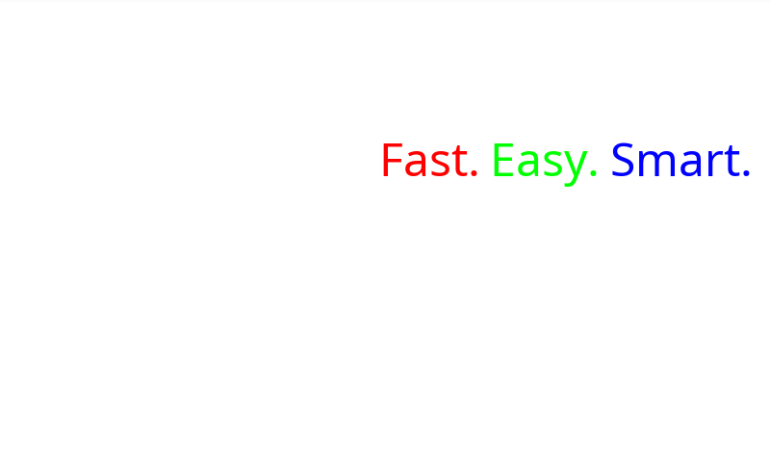

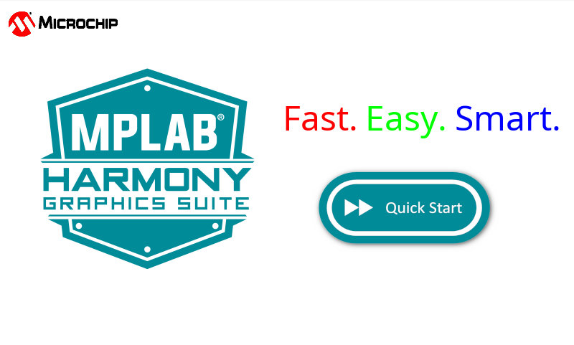
Behind the Scenes
Memory
(DDR or Internal SRAM)
Multi-Layers using HW Overlays
Layer 0 Frame Buffer
Legato Graphics Library
Layer 1 Frame Buffer
Scratch buffer
Layer 2 Frame Buffer
Layer Composition
Integrated Display Controller

Slide 37
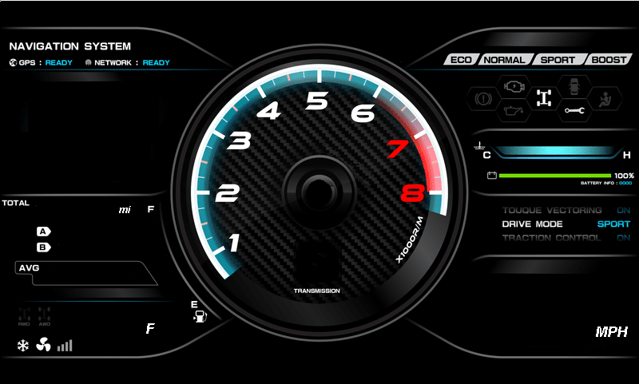
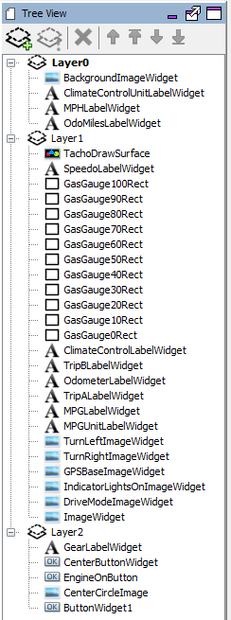
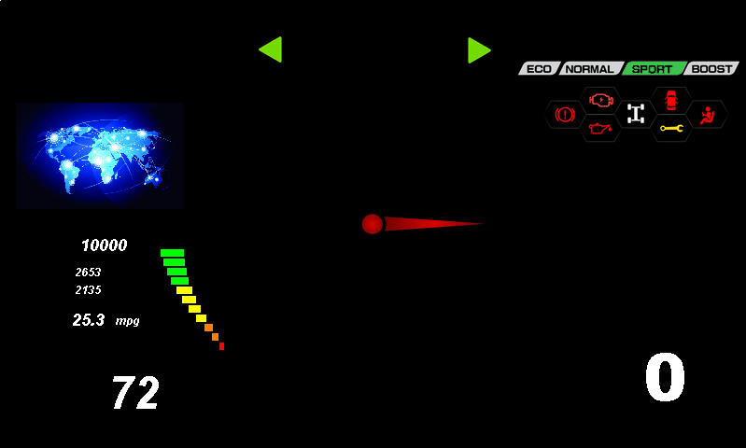
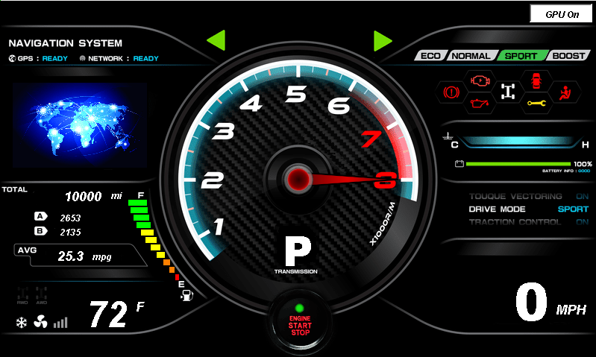

Pro Tip: Use Layers to Overlay Dynamic Content
Best Practices
Static background, drawn once
Can use compressed background images
Save space without sacrificing performance
Use middle layer for non-interactive, dynamic content
Show dynamic content without redrawing background
Use top layer for interactive UI controls and static overlays
User input is instantly captured
Minimize redraw of controls
Less redraw = better performance

Slide 38




Pro Tip: Use Layers for Transparency Effects
Best Practices
Use base and middle layers for main screen widgets and controls.
aria_image_viewer
Use top layer to overlay a semi-transparent frame (e.g., help info)
Use effects like fade in/out
Show new content without fully obscuring contents below
Per-pixel or per layer alpha blending
Smooth transparency effects without loading the CPU.

Slide 39
Graphics Canvas
Virtual Display

Slide 40

What is the Graphics Canvas?
Virtual Display
Legato Library
Application
A ‘Virtual Display’ software layer for
Storing or pre-rendering Frame with the GFX Library
Configuring the Display Controller Layers to display the Frames
Applying effects like Motion, Sliding Panels, Sprite Animation, Cropping, Screen Transitions and Fade In/Out using Display Controller Layers
Frame data
Interface Functions
GFX
Canvas
Canvas
Object 1
Canvas
Object 2
Display Driver IOCTL
Canvas
Object 3
Frame Buffer
Display Driver
Display Controller
PLIB
Display Controller

Slide 41
Canvas Object
Graphics Canvas
A Canvas Object contains frame information
Buffer address, resolution, color mode
Layer ID, size, position, alpha
Layer effects status and settings
A Canvas Object is assigned a HW Layer in the Display Controller
Application calls Canvas APIs to set Display and Effects settings
Application
GFX
Canvas
Display
Controller
Canvas
Object
HW Layer

Slide 42



Composer and Canvas Integration
Graphics Canvas
Each composer Layer is mapped and rendered to a Canvas object at the same z-order**
# Canvas Objects != HW overlays
Allows as many layers/canvas as RAM can support!!!
Pro Tip
Use Layer Editor Options to Hide/Show Layers in the Composer Editor Window

Slide 43



Application Interface
Using the GFX Canvas
gfx_canvas.c/h – Core module, private functions, glue code to library and display controller driver
gfx_canvas_api.c/h – Public module, interface functions
During Initialization *
At Run-time **
Set a Canvas property (Show)
Set multiple Canvas properties
Assign HW Layers to Canvas Objects
Set Canvas Window Size
Hide (or Show) Frames at Init
*legato_climate_control, **legato_dashboard
Apply Canvas Settings. HW Layer changes are applied in next VBLANK Period

Slide 44



Application Interface
Adding Effects
Canvas supports Move and Fade effects***
During Initialization *
Start a Move Effect *
Application can register callbacks to be notified of the Effects Status for each Canvas Object
Move a Canvas Object with speed up/down/fixed motion, start/end positions, move steps.
Start a Fade Effect **
Fade a Canvas Object (in Layer 1), with start/end Alpha value, step value
Fade another Canvas Object (in Layer 2), with start/end Alpha value, step value
*legato_climate_control, **legato_dashboard, ***HW overlay dependent

Slide 45







Canvas Applications
Angle | Address | Size | Position
0 | 0x80012070 | 83 * 23 | (627,238)
2 | 0x800120a8 | 86 * 24 | (626, 235)
…
N | 0x80012118 | 87 * 33 | (623, 191)
Application Code
Sprite Animation
GFX Canvas can be used to do sprite animation of multiple RAW images in memory
Images must have the same color mode as Canvas Object
A HW layer is assigned to the Canvas Object
The Pixel Buffer for the Canvas Object is updated to the address of the current image to be shown
Graphics Canvas
HW Layer
Set the pixel buffer for the canvas, based on needle image address and size in DDR
RAW Images in DDR (RGBA8888)
Set Window based on needle image position and size
Apply the Canvas settings
**legato_dashboard

Slide 46



Task 4 Implementation
[…]
14 images
Use Raw Uncompressed Images!
800
58x48
480
261
Canvas for Sprite
161

Slide 47



Task 4 Implementation
2
Declaring array
Of sprite images
1
Assign Canvas Object 0 to HW Layer 0, Setting Position and size
Assign Canvas Object 1 to HW Layer 1, Setting Position and size
Assign Canvas Object 2 to HW Layer 2, Setting Position and size
3
Assign Canvas Object 3 to HW Layer 2 for sprite, Setting Position and size
Setting the next sprite image in the array to the required pixel location
Showing the updated Canvas

Slide 48
Task 5 & 6
More Animation Techniques

Slide 49
Task 5
Image Sequence Widget

Slide 50

Task 6
Panel SetWidth API
Appears if Screen1 is idle for 10s
After 10 s goes back to previous screen

Slide 51
Task 7
The Final Application

Slide 52





Modifications
Layer 0 – All assets for “Scene 0” and “Scene 2”
Logo Animated using setPosition API
SCENE 0
SCENE 2

Slide 53


Modifications
Layer 1 – All assets for “Scene1”
Widgets set visible but disabled

Slide 54

Modifications
Layer 2 for Sprite Animation of the Charge Cable

Slide 55
Modifications
Use Canvas to Swap Scenes

Slide 56


Questions?
Notes:
5.5 hours in (END)

Slide 57
Important Resources
MGC Suite Wiki:
https://github.com/mchpgfx/legato.docs/wiki
Previous Harmony Graphics trainings:
https://microchiptechnology.sharepoint.com/sites/HumanInterface/SitePages/Legato-Graphics-Workshop-Series.aspx
Contact Kristy Seymour to gain access to sharepoint Link
Contains Basic and Advance trainings including recordings of the presentations

Slide 58
Thank You

